Slide 1
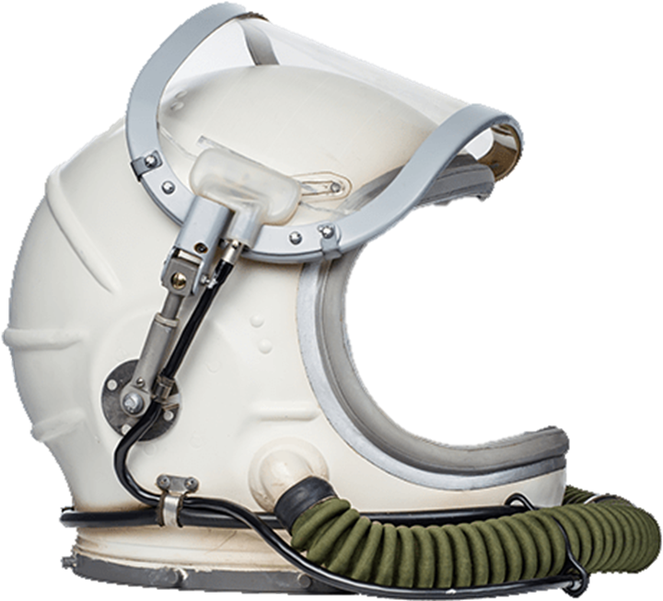
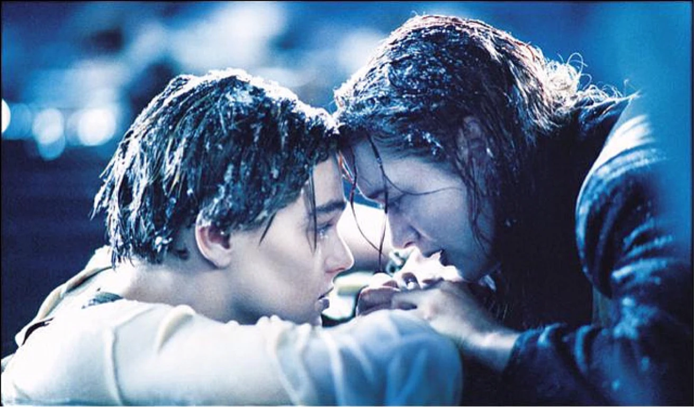
SPACESHIP
TITANIC SURVIVAL PREDICTION
Saffian Asghar
Emilio Espinosa Sanchez

Slide 2
WORKFLOW
EDA
Analyze the data, filter significant attributes, substitute missing values
BUILD FEATURES & CATEGORIES
Analyze key features and build new ones for prediction
MODEL
Select and build suitable models depending upon your data
COMPARISON AND ATTRIBUTES SELECTION
Train your model and test it with an unseen sample.
Compare different models results and accuracy

Slide 3
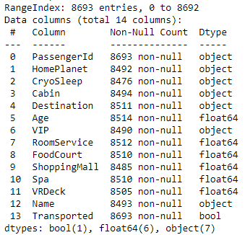
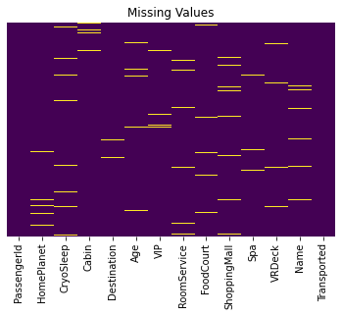
EDA

Slide 4
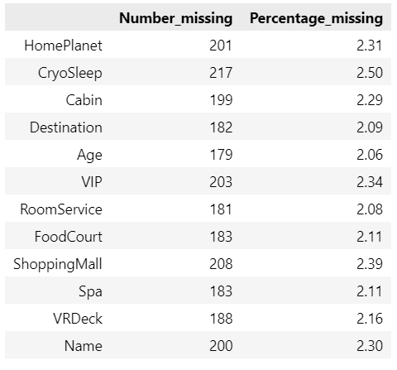
EDA
Missing Values
HomePlanet & Cabin
Group by the passenger’s group and fill using bfill and ffill
Cryosleep
Using bfill and ffill by passenger group.Compare spending and set cryosleep to 0 if they had some spending
Destination
Compare HomePlanet and substitute for mode
Age
Compute mean age by HomePlanet and substitute for missing values
VIP
Missing value considered as not a VIP, set to False
Expenditures
Null values substituted for 0

Slide 5
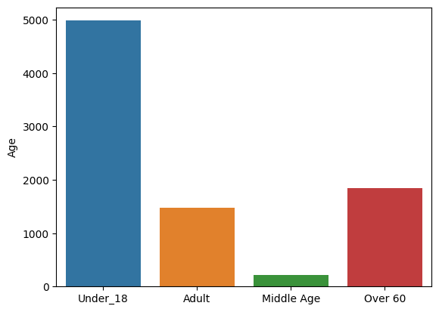
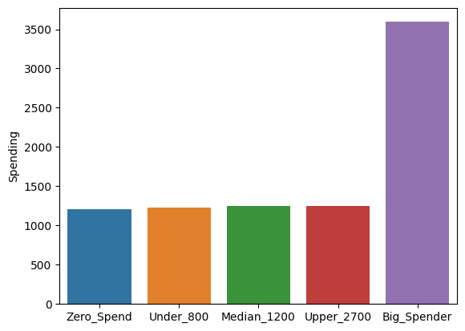
BUILDING CATEGORIES
Age
Spend Category
Categorize age groups with respect to data (Avoid empty bins)
Convert each bin to numerical value
Categorize with a similar approach as in age
Convert each bin to a numerical value

Slide 6
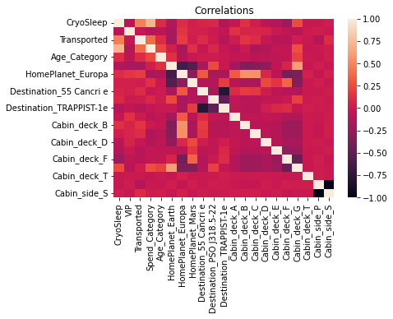
EDA-CORRELATIONS

Slide 7
Naive Bayes

Slide 8
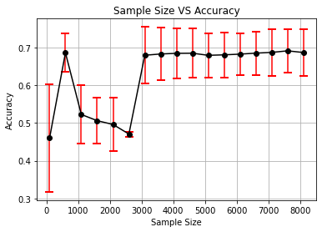
NB - Varying sample size
Range: 100:8500.
Step: 500.
CV: 10 folds
Bigger the sample = + Accuracy (mean) and - error (std)
Notes:
# Accuracy: how good we were in recognizing positive and negative
# Precision: how correct the classifier is
# Recall: how complete the classifier is
# F-Score: combination of presition and recall

Slide 9
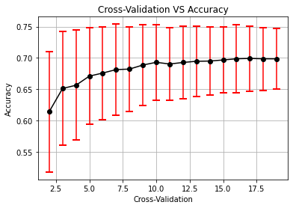
NB - Varying cross-validation
Range of CV: 2:20.
More CVS = + Accuracy (mean) and - error (std) but not always significant
Notes:
# Accuracy: how good we were in recognizing positive and negative
# Precision: how correct the classifier is
# Recall: how complete the classifier is
# F-Score: combination of presition and recall

Slide 10
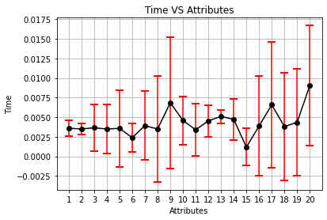
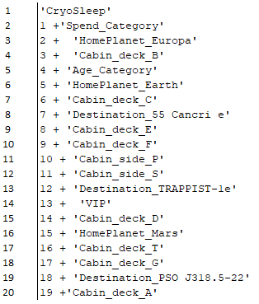
NB - Time vs # attributes
Total number of attributes: 20
CV: 10
Selection mode: SelectKBest
Lowest std at 13.
Lowest computing time at 15.
Notes:
# Accuracy: how good we were in recognizing positive and negative
# Precision: how correct the classifier is
# Recall: how complete the classifier is
# F-Score: combination of presition and recall

Slide 11
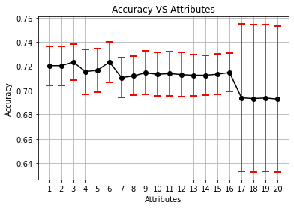
NB - Accuracy vs # attributes
Total number of attributes: 20
CV: 10
Selection mode: SelectKBest
Best accuracy is with 6 attributes
Notes:
# Accuracy: how good we were in recognizing positive and negative
# Precision: how correct the classifier is
# Recall: how complete the classifier is
# F-Score: combination of presition and recall

Slide 12
Decision Tree

Slide 13
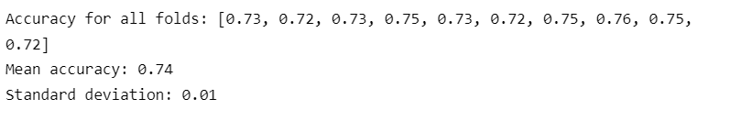
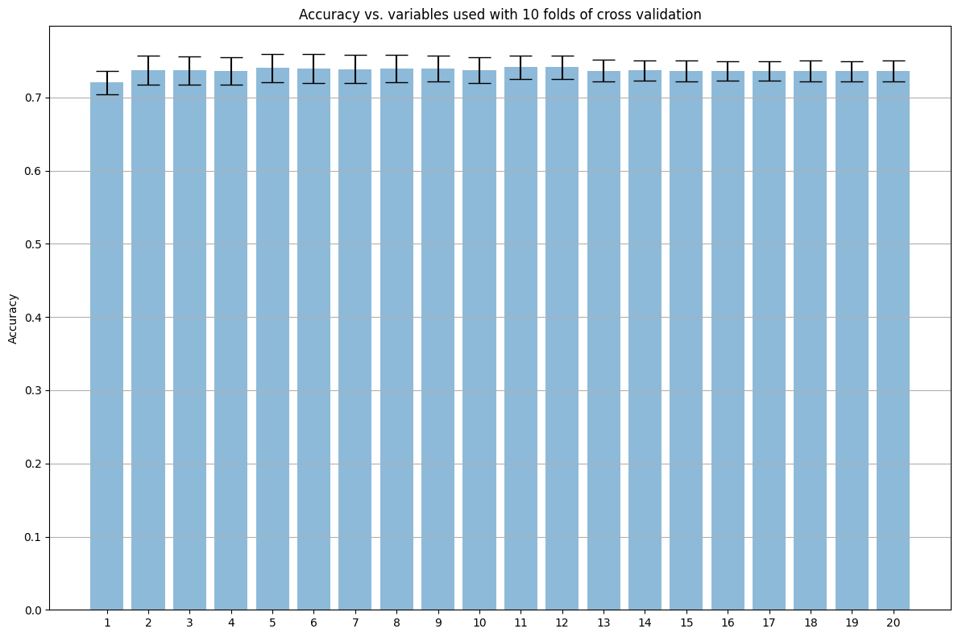
Full Decision Tree
Accuracy of full decision tree using different features from SelectKBest

Slide 14
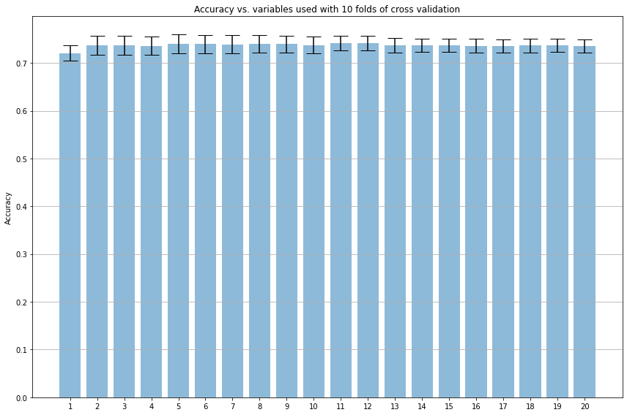
DT - Accuracy vs # attributes
Total number of attributes: 20
CV: 10
Selection mode: SelectKBest
Notes:
# Accuracy: how good we were in recognizing positive and negative
# Precision: how correct the classifier is
# Recall: how complete the classifier is
# F-Score: combination of presition and recall

Slide 15
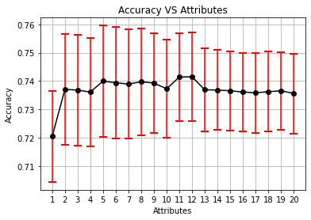
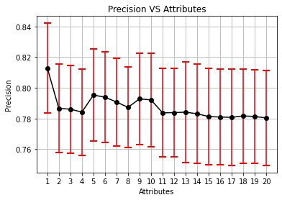
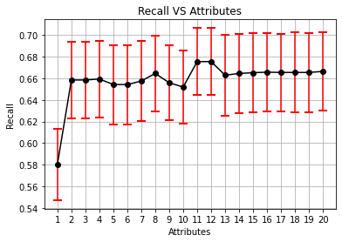
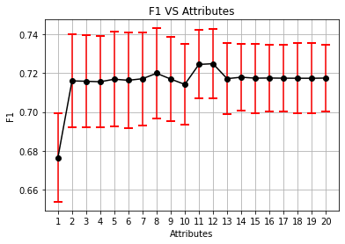
DT - metrics vs # attributes
Notes:
# Accuracy: how good we were in recognizing positive and negative
# Precision: how correct the classifier is
# Recall: how complete the classifier is
# F-Score: combination of presition and recall

Slide 16
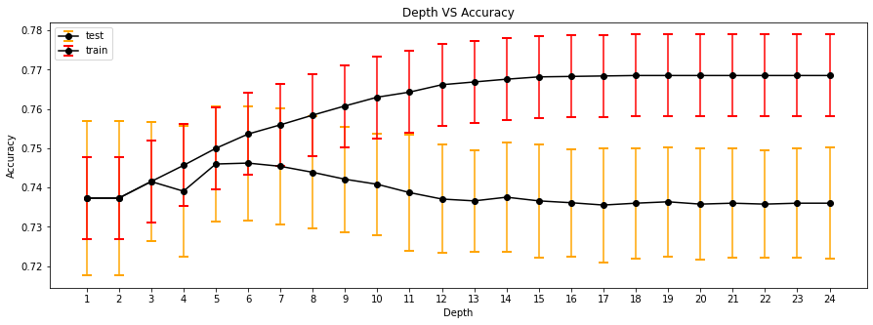
Full Decision Tree
Depth vs Accuracy
Effect of tree depth (number of splits before prediction) on accuracy

Slide 17
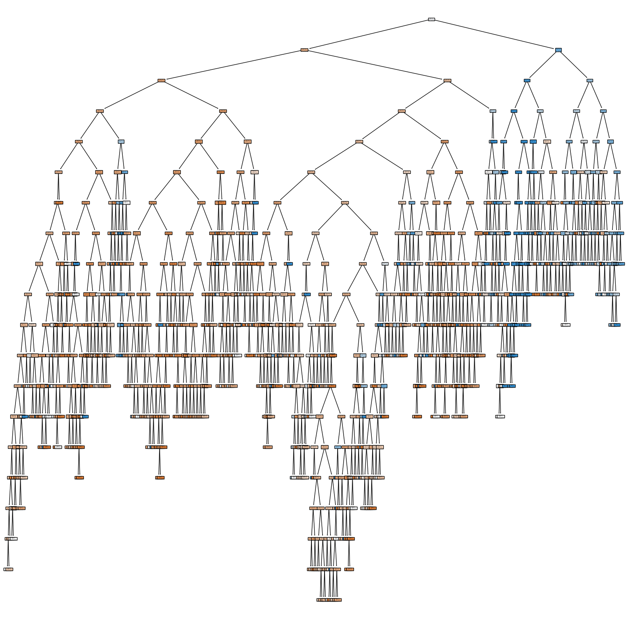
Full Decision Tree

Slide 18
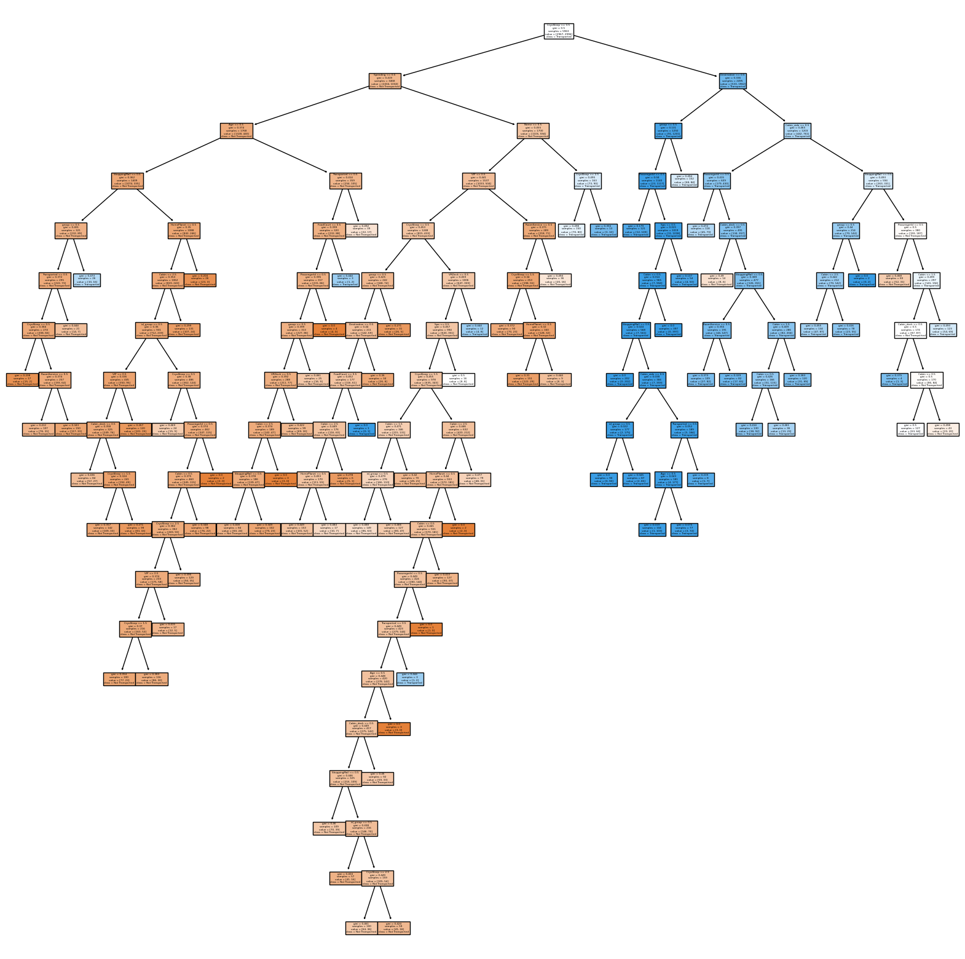
Tree after Pre Pruning

Slide 19
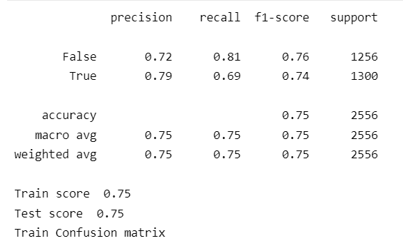
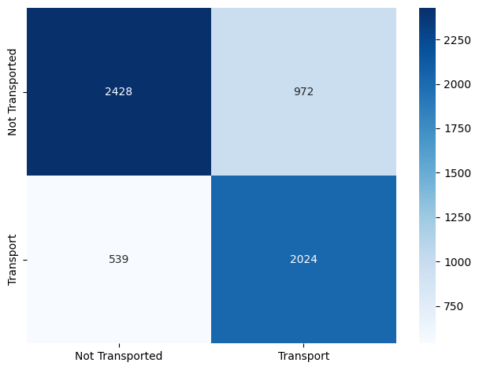
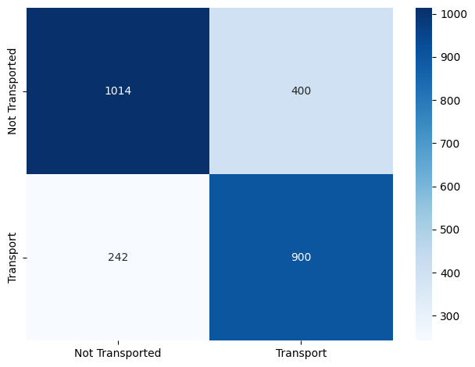
Pre Pruning
Train Confusion Matrix
Test Confusion Matrix

Slide 20
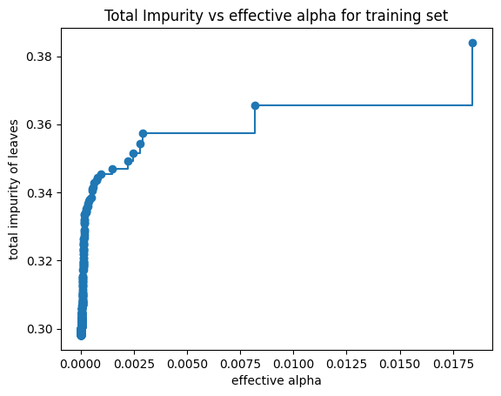
Post Pruning
Minimal cost complexity pruning recursively finds the node with the “weakest link”
The weakest link is characterized by an effective alpha, where the nodes with the smallest effective alpha are pruned first
In the following plot, the maximum effective alpha value is removed, because it is the trivial tree with only one node

Slide 21
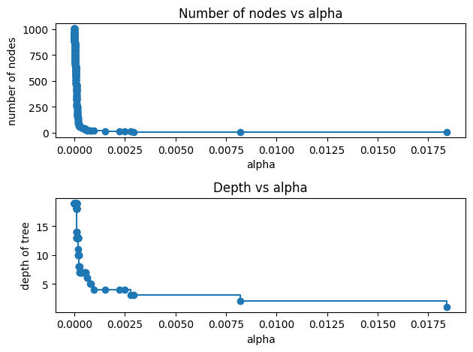
Post Pruning
Here we show that the number of nodes and tree depth decreases as alpha increases

Slide 22
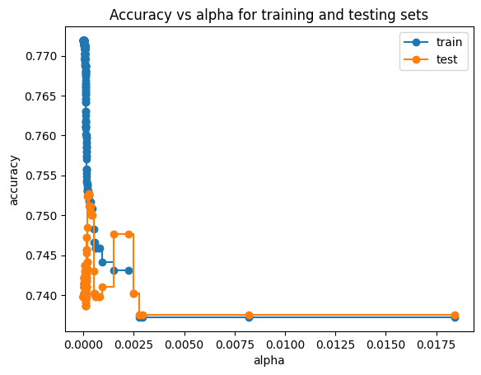
Post Pruning (cost-complexity)
As alpha increases, more of the tree is pruned, thus creating a decision tree that generalizes better

Slide 23
THANK YOU
Saffian
Emilio

